Slide 1
Generalized Overlapping Group Lasso for Patients Subgroups Selection
Wenxuan Deng

Slide 2
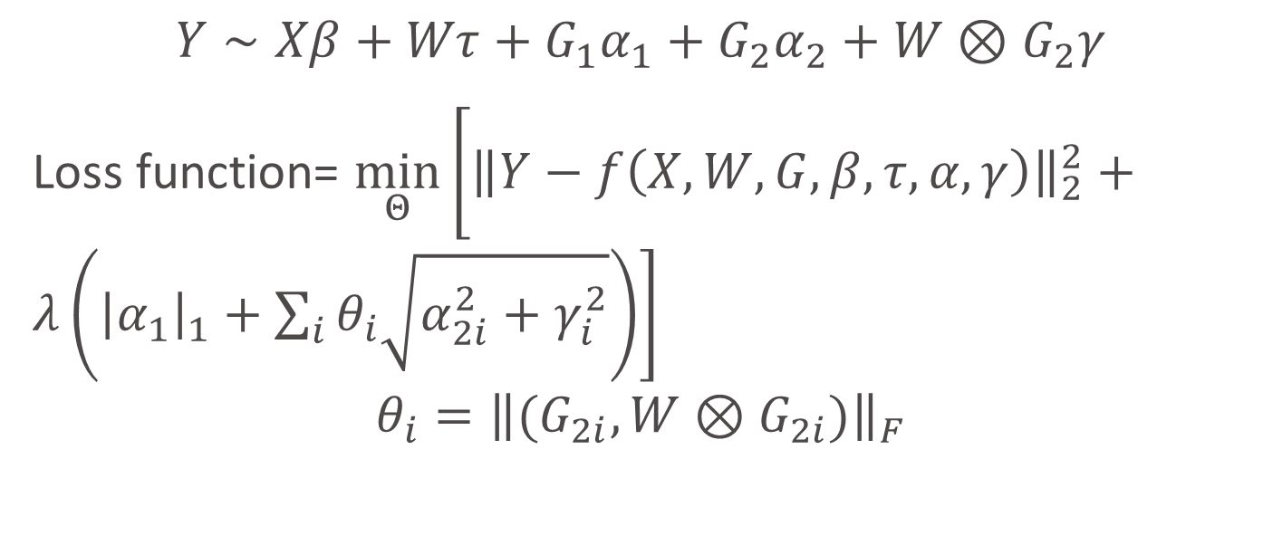
Model
Baseline Variable
Treatment Variable
Main/Interaction Effects of Genes
$$Y∼Xβ+Wτ+G_{1}α_{1}+G_{2}α_{2}+W⊗G_{2}γ$$
Loss function= $\min_{Θ}\left[{\left\|Y−f\left(X,W,G,β,τ,α,γ\right)\right\|}_{2}^{2}+λ\left({\left|α_{1}\right|}_{1}+\sum_{i}{θ_{i}\sqrt{α_{2i}^{2}+γ_{i}^{2}}}\right)\right]$
$$θ_{i}={\left\|(G_{2i},W⊗G_{2i})\right\|}_{F}$$

Slide 3
Simulation Setup
N=100
Dimensions for baseline variables = 2
Dimensions for treatment variable = 1, (binary: +1,-1)
Dimensions for Genes = 30, 100
30% of hierarchical interaction effects are non-zero randomly
20%~50% of gene main effects are non-zero
Iterations: 100

Slide 4

Signal/Noise ratio
For 30 genes: 0.5, 1, 5, 10, 100.
For 100 genes: 1, 10, 100.
$SNR=\frac{var(y_{0})}{var(ε)}$, where $y=y_{0}+ε$

Slide 5

Strong/Weak Signals
The absolute of signals are leveled into four groups:
(0, 0.1), (0.1, 0.4), (0.4, 0.85), (0.85, $+∞$)
The proportion of four groups are: 8%, 22%, 30%, 40%

Slide 6
Others
False Discovery Rate (FDR)
False Negative Rate (FNR)
Optimal Lambda
MSE

Slide 7
30 genes

Slide 8
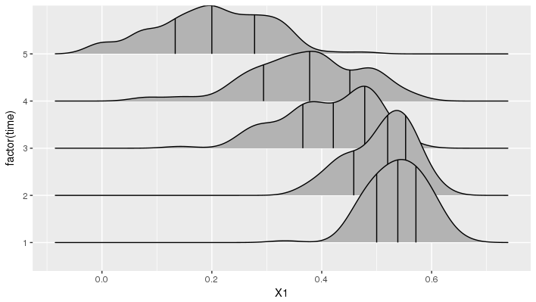
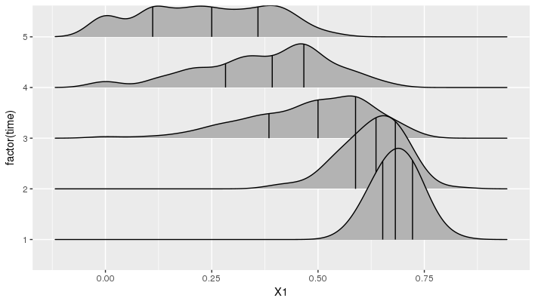
FDR
Main
Interaction

Slide 9
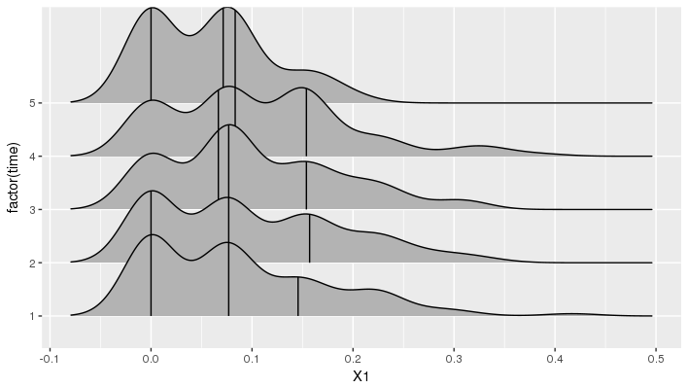
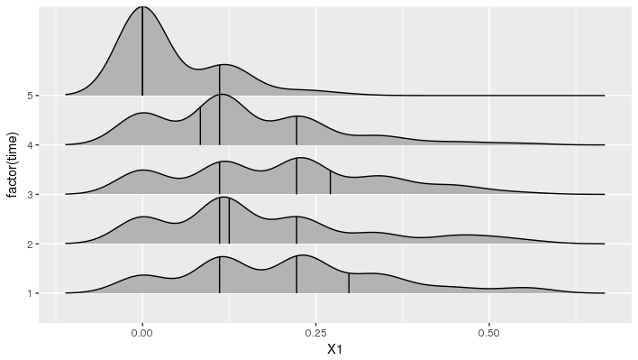
FNR
Main
Interaction

Slide 10
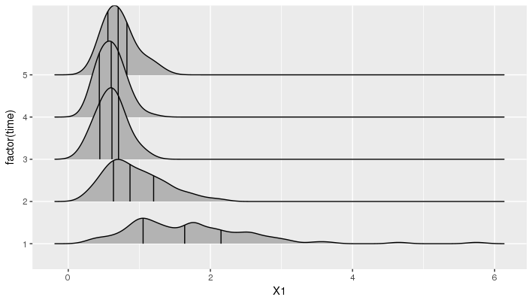
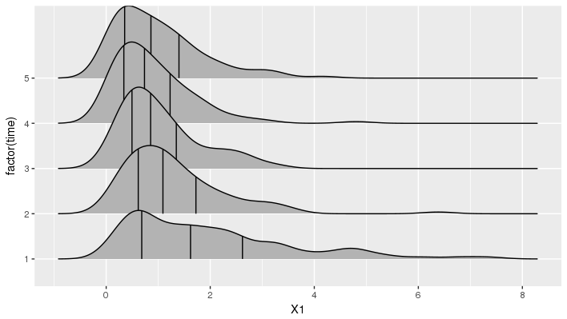
MSE
Genes
Genes+baseline

Slide 11
Strong/Weak Signal
Main Effects Correct Rate
Interaction Effects Correct Rate
 | 1 | 2 | 3 | 4
mean | 0.402 | 0.675 | 0.862 | 0.966
 | 1 | 2 | 3 | 4
mean | 0.349 | 0.576 | 0.825 | 0.951

Slide 12
100 genes

Slide 13
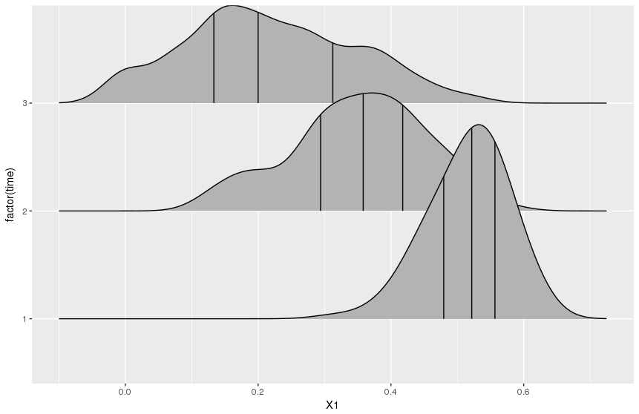
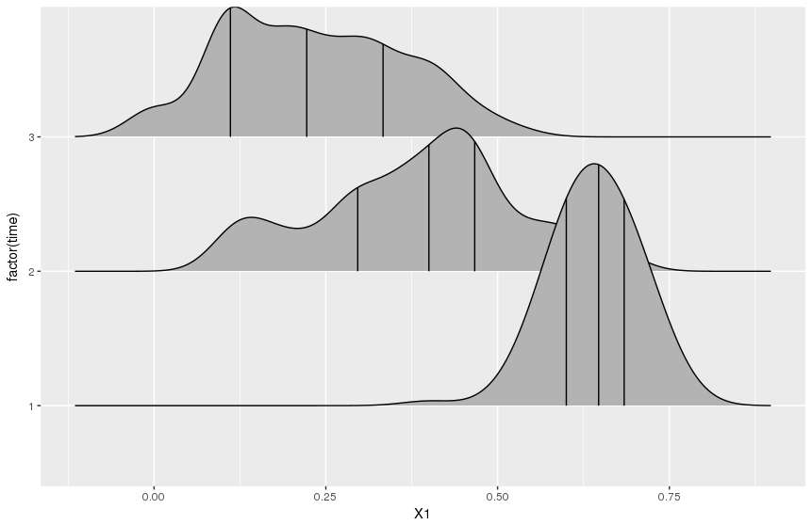
FDR
Main
Interaction

Slide 14
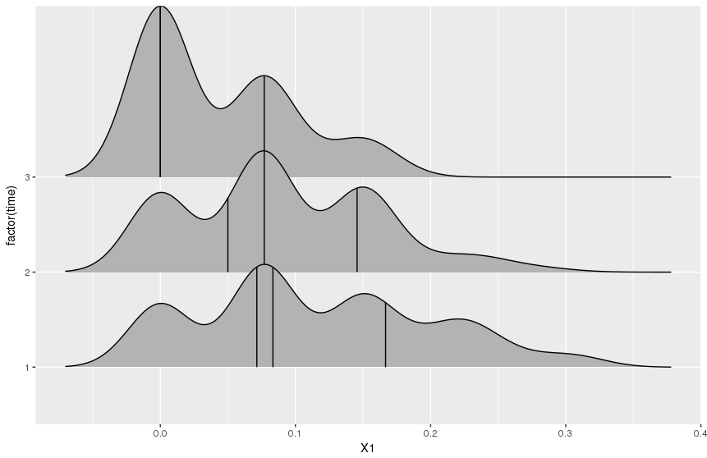
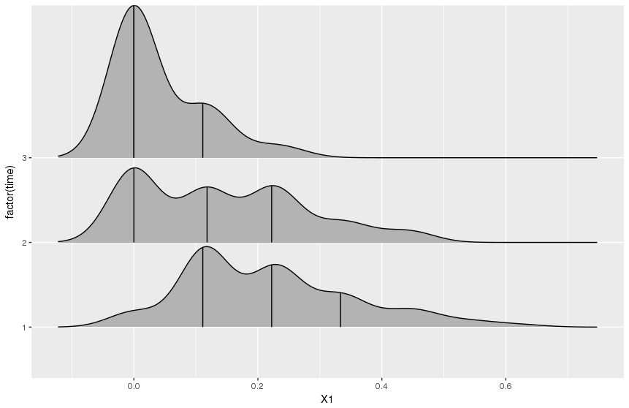
FNR
Main
Interaction

Slide 15
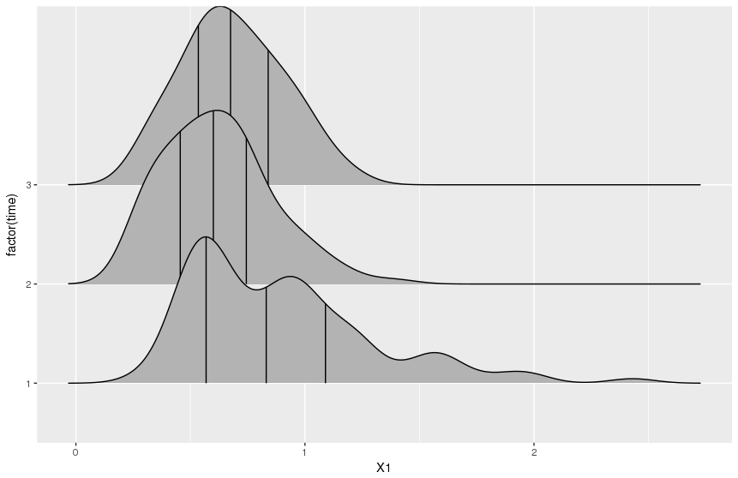
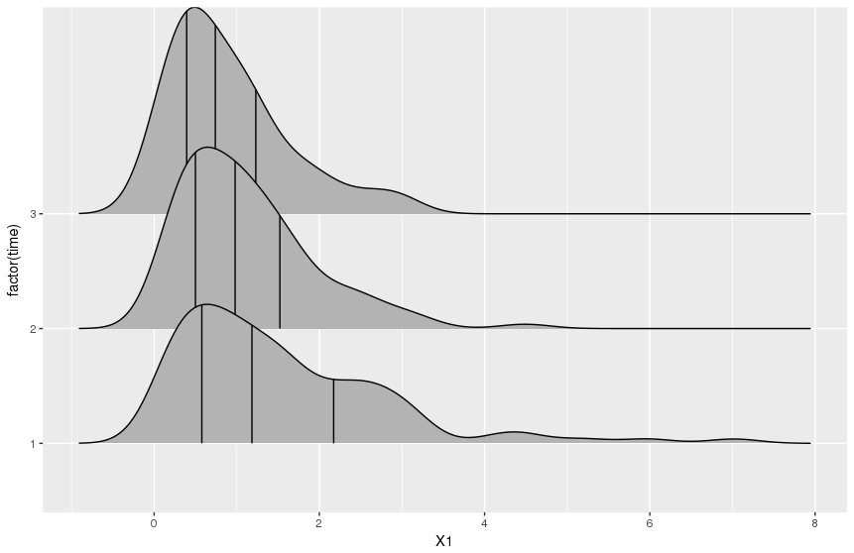
MSE
Genes
Genes+baseline

Slide 16
Strong/Weak Signal
Main Effects Correct Rate
Interaction Effects Correct Rate
30 genes | 1 | 2 | 3 | 4
mean | 0.402 | 0.675 | 0.862 | 0.966
30 genes | 1 | 2 | 3 | 4
mean | 0.349 | 0.576 | 0.825 | 0.951
100 genes | 1 | 2 | 3 | 4
mean | 0.386 | 0.740 | 0.910 | 0.983
100 genes | 1 | 2 | 3 | 4
mean | 0.307 | 0.633 | 0.863 | 0.976

Slide 17
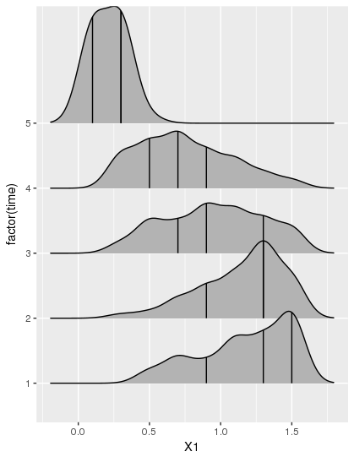
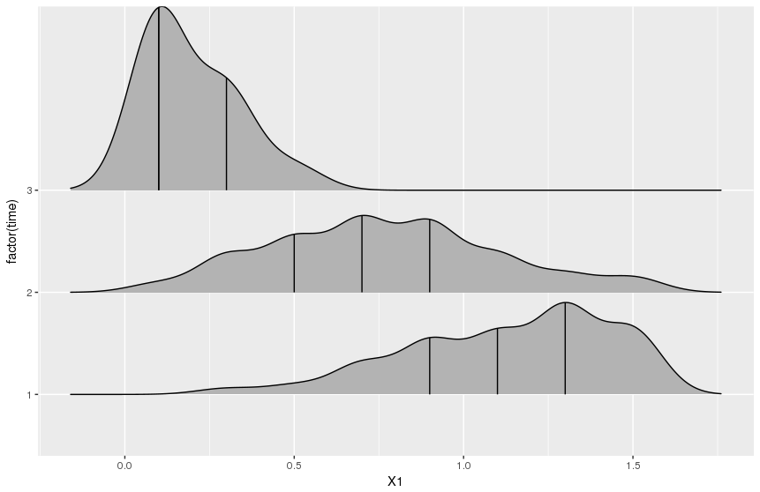
Optimal Lambda
30 genes
100 genes

